Slide 1



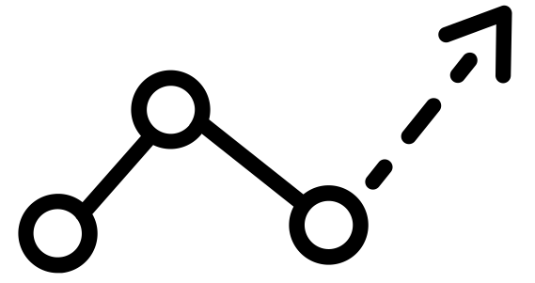
Sustainable value proposition canvas
HACKATHON TOOLKIT
VALUE PROPOSITION TYPES
Select the value your are bringing
Define your Sustainable proposition
PEOPLE
PLANET
PROFIT
PROGRESS
Helps you articulate and translate the value being created within your new sustainability business or innovation concept. This tool will help you structure the value being created, alongside the KPI’s and metrics you will use in order to quantify your value impact.
Construct clear value proposition statements for sustainable business concepts
Incorporate KPI’s and metrics into your value proposition statements
Design your value proposition through the use of a simple ad-lib helper
Social desirability
Environmental necessity
Economic
Viability
Technological
Feasability
VALUE PROPOSITION KPI’S & METRICS
Which specific metrics will you use to track your chosen value type
Metrics or KPI’s
Metrics or KPI’s
Metrics or KPI’s
Metrics or KPI’s
VALUE PROPOSTION STATEMENT
What´s the solution about
What is it?
What problem does it solve? (pain points)
Why is it different?

Slide 2







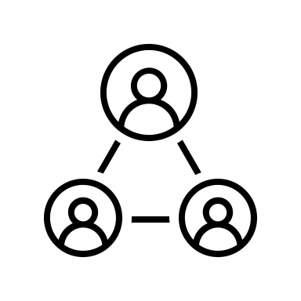
Pitch canvas
HACKATHON TOOLKIT
SIMPLE STATEMENT
Prepare your impactful Pitch
A memorable one-sentence explanation of what you do for customers ?
PROBLEM
PRODUCT
What problem are you solving for your custiomer
What does the pain result in ?
What opportunities do you provide for people to be more
As simply as possible : what your product do for customers
How does it work ?
Build the storyline of your pitch, covering all essential building blocks: problem, solution, business model, credibility, and call to action.
The pitching canvas is a tool to build the storyline of your pitch, covering all essential building blocks:
Problem
Solution,
Business model
Credibility
Call to action
PRODUCT DEMO
WHAT’S UNIQUE
Show live demo
Mockup or screenflow
Technology/Relationships/Paternships
How do you help your customers get results differently to your alternative ?
CUSTOMER TRACTION
BUSINESS MODEL
Pilot customers ?
Customer reference quotes ?
Use data and facts to strenghten your case
How do you get paid ?
What’s the opportunity for growth ?
RESOURCES
PARTNERS
What are your key ressources ?
Who are your key partners
Who are your key suppliers ?
END STATEMENT
Finish the pitch strongly with clear message of the TO BE impact

Slide 3
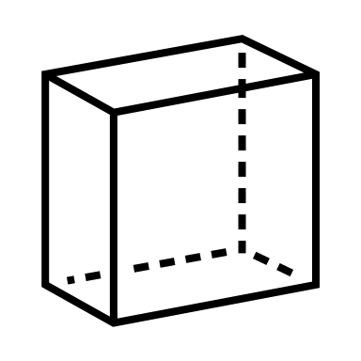





CONCEPT BOARD
Concept board canvas
HACKATHON TOOLKIT
CONCEPT NAME
Describe your idea in a simple, concise and impactful sentence
FEATURES
DESCRIPTION
FEATURES
Explain your unique concept
DESCRIPTION
Identify the major features of your product or concept
Describe your idea in a simple, concise and impactful sentence
Identify the major features of your product or concept
Describe your idea in a simple, concise and impactful sentence
A concept must be clear and explicit. The concept board helps you to clarify your idea by detailing several dimensions.
the completion of the concept board will help you keep a clear vision of your concept and avoid getting stuck on details or too precise points that prevent you from imagining the big picture.
BENEFIT
CUSTOMER
BENEFIT
CUSTOMER
what benefits for the planet does your concept bring
who is your concept aimed at?
who is involved in your concept
LEVERS
BARRERS
LEVERS
BARRERS
What obstacles do you identify?
Which accelerators do you identify
What obstacles do you identify?

Slide 4



Hackathon rating scale & evaluation criteria
SCORING
Technology
XX/10
-Is the tech stack, architecture the infra selected adequate to build and scale the solution?
-Are best coding practices being followed?
-Were you able to deploy the solution on a cloud? Where is the demo running from?
-Is the UX part of the solution appealing to your user target group?
Innovation
XX/10
-Is your product innovative enough? How does it differentiate from similar offerings already out there in the market?
Sustainability
XX/10
-How is your solution sustainable? And how can it remain to be at scale?
-What is the impact of the solution?

Slide 5


Hackathon rating scale & evaluation criteria
SCORING
Feasibility
XX/10
-How feasible is to launch your product in the real world?
-What would you need to do so?
Pitch
XX/10
-How effective and convincing are you when presenting your solution and business case to potential investors and your target audience?

